Slide 1

Marketing New Orleans Properties to the Modern Client
David Favret
French Quarter Realty
davidfavret.com
Notes:
Anyone here from Cleveland?

Slide 2

“America has only three cities:
New York, San Francisco and
New Orleans.
Everywhere else is Cleveland.”
-Tennessee Williams
Notes:
We are fortunate to be able to market and sell such a unique product.
You have had two great presentations on the history and the architecture of the neighborhoods and what I would like to talk to you about is the intangible beyond location, convinces and amenities of a neighborhood. What we are selling, particularly in our historic neighborhoods, is our culture.
Our multigenerations still living in one area
Our cuisine and our unique relationship with food
Our natural connection to our history, particularly as it relates the unique customs and practices as a result of our not so distant past as a French and Spanish colony
It is often the culture of the neighborhood that we are selling to a buyer or for a seller on the listing side

Slide 3
Notes:
We will talk about marketing a little later, but first let’s talk about our “Modern Client”
By a show of hands, who has been in the business for a year or less? 5 years? 10 years? This is the group that I fall in. 20 or longer? You have all obviously found success developing and communicating with your existing clientele, but what we are going to talk about this morning is our new “Modern Client”

Slide 4

Notes:
The Millennial
While I recognize that each of our clienteles maybe different from agent to agent, this new client or Millennial is rapidly becoming the dominating force in the market today. As we begin to address this topic perhaps we need to define this group, at least in broad terms and talk about how they are different from the generations that came before

Slide 5
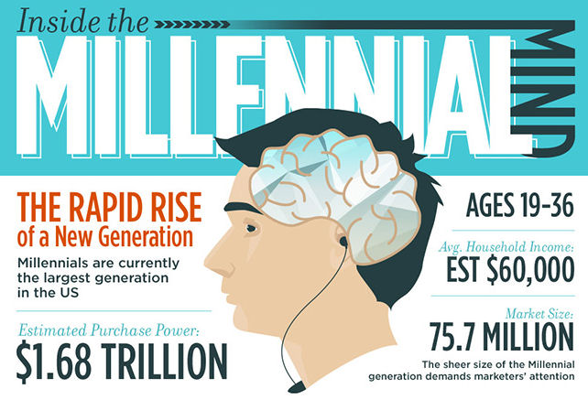
Notes:
Millennials—While there is not a precise beginning to this generation, millennials are born after 1980 and have come of age near the millennium. So for analyzing statistics as it relates to today’s topic we are talking about 19-36. While this might not look like your current client, it will. Think of the children and in some cases, grandchildren of your existing clients.
This group is just starting to reach peak buying power and they making their mark on the market. It is estimated that this group accounts for almost $1.7 trillion in direct annual spending—larger than any other segment of the population. They are the consumer market of the future.
According to the Brookings Institution
Millennials make up roughly 25 % of the current U.S. population at about 76 million Millennials currently exceed the number of Boomers by a few million.
By 2020, Millennials will comprise more than 1 in 3 American adults
By 2025, Millennials make up 75% of the work force in the U.S.
By 2030, Millennials will outnumber Boomers 78 million to 56 million

Slide 6
“Millennials, those born between 1982 and 2003, are "a cohort whose dominating presence will make its behaviors the major motif of American life in the next decade"
–Brookings Institution
Notes:
Millenials are:
America’s most racially diverse generation 43% non-white. ½ of all newborns are non-white. By 2043, the majority of the population will be non-white.

Slide 7
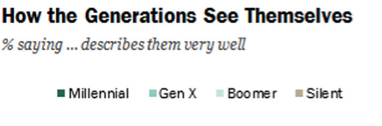
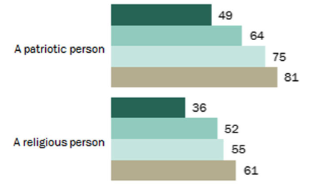
Notes:
50% of Millennials identify as political independents
29 % are not affiliated with any religion
These 2 statistics are the highest political and religious disaffiliation recorded for any generation.
In response to being questioned about patriotism,
49% say the phrase a patriotic person” describes them well.
By contrast, 64% of Generation Xers,
75% of Boomers and
81% of the silent generation

Slide 8
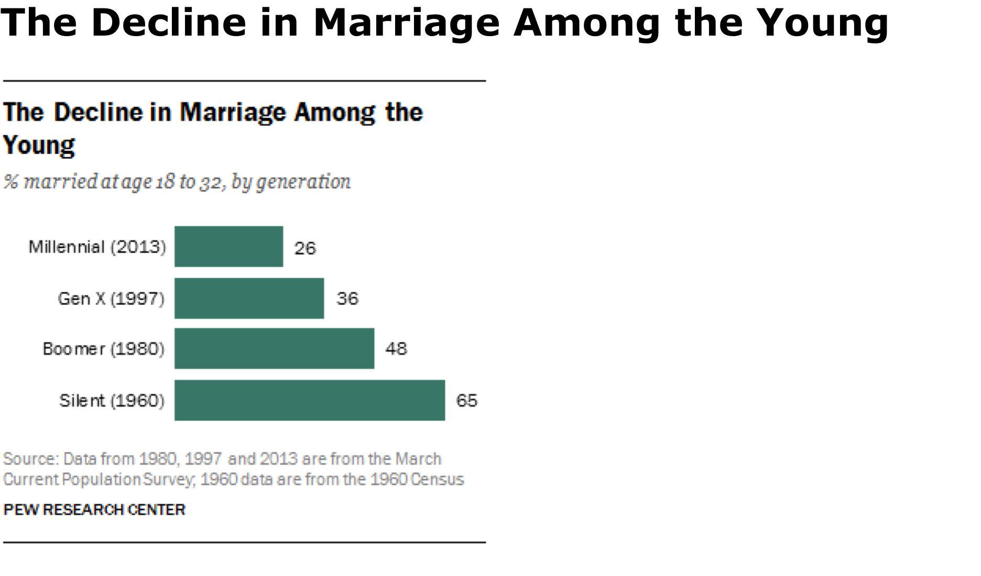
Notes:
They also stand in contrast to previous generations with respect to another core institution of society—marriage
Post college-aged Millennials are also the most educated generation of young adults in American history with more than 1/3 having a four-year degree or greater.

Slide 9
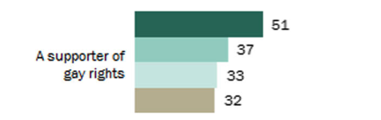
Notes:
Millennials stand out for liberal views on most social issues including marriage equality and legalization of marijuana.

Slide 10

Notes:
This generation barely remembers a time without internet, lap tops, smart phones, and social media.

Slide 11

Notes:
To sell to any audience, you have to understand it. Now that we have talked a little bit about the characteristics of this group, let’s take a look at how this generation thinks, acts, what they are buying and perhaps with this analysis, re-evaluate the way that we engage them.

Slide 12

Notes:
Speak to the values drive this generation. They may not be what you would think.

Slide 13
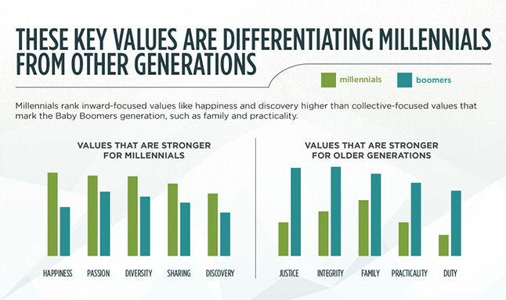
Notes:
Understand their lifestyle and desired experiences and find ways to amplify their reality

Slide 14
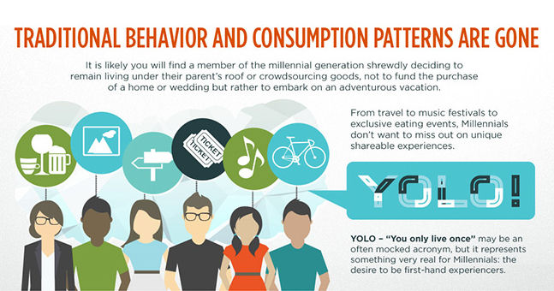

Slide 15
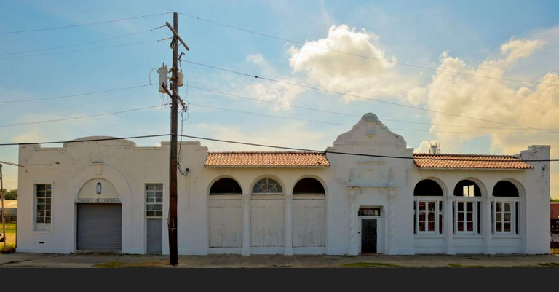

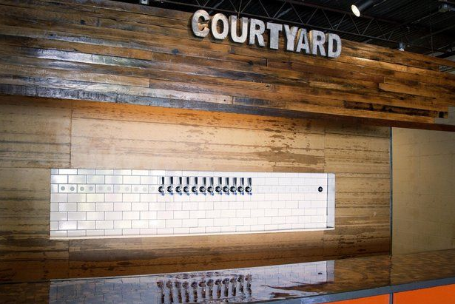

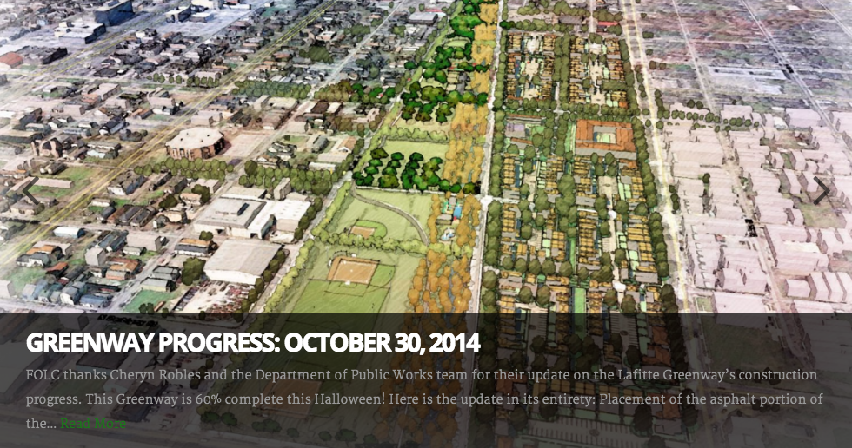
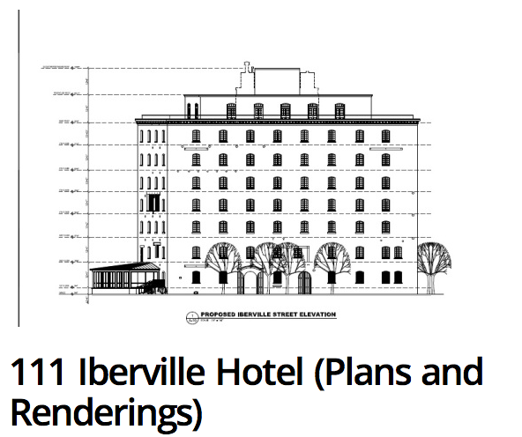
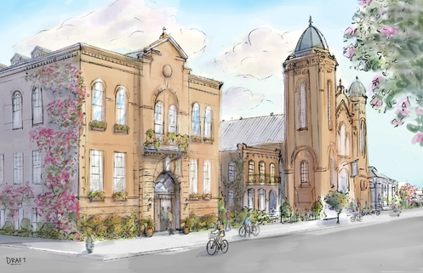
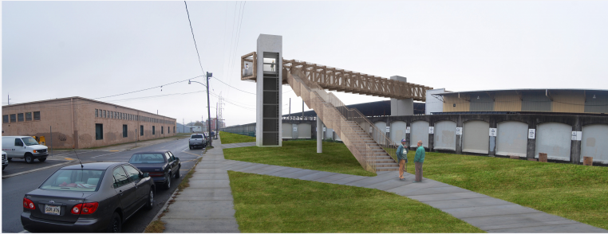

Notes:
Sell the cool, know what’s coming. The walkable/bikeable, sustainable neighborhood, public transit, parks etc.
Make sure that they are informed and involved and not told what to do. Embrace “multidirectional engagement”—they want to be collaborators.

Slide 16
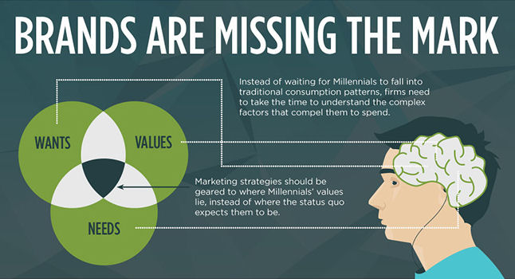
Notes:
Now, What are they buying?

Slide 17
URBAN
Notes:
You guessed it. Urban.

Slide 18
URBAN = HISTORIC
Notes:
And for us that is historic.
Millennials are opting for city life over the suburbs that raised them. What they are looking for is the perception of cultural cool. And this is what we are selling.

Slide 19

Notes:
The number of college educated people 25-34 living within 3 miles of a city center is up 37% since 2000—even as the total population slightly decreased in some of the same cities. New Orleans is one such city. This trend continues to dominate our market, both in terms of volume and value.
This is not going unnoticed in the suburbs. Planners in these areas are attempting to manufacture “density”.

Slide 20
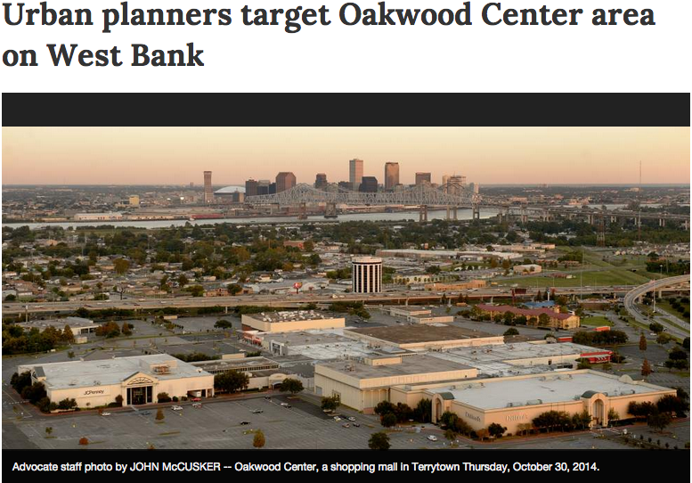
Notes:
The attempt is make neighborhoods walkable and deemphasize sprawl. Just last week, the Advocate did a story on this concept and the plans to center a city vibe around Oakwood mall.
National Association of Realtors analyzed 100 metro areas that have a large Millennial presence, solid local job market conditions and strong migration patterns of young adults moving to that particular area to determine the best purchase prospects for young buyers. Housing affordability and inventory availability were also considered.
Any guesses as to the top 10?

Slide 21
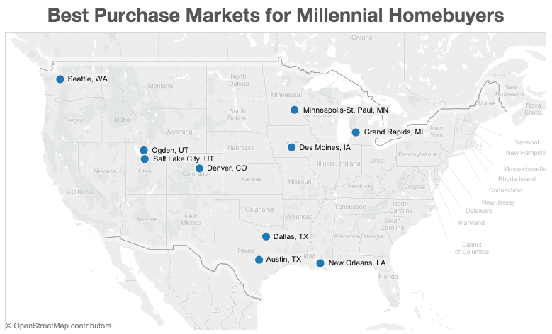
Notes:
The best purchase markets for aspiring Millennial homebuyers are (listed alphabetically):
Austin, Texas
Dallas
Denver
Des Moines, Iowa
Grand Rapids, Michigan
Minneapolis
New Orleans
Ogden, Utah
Salt Lake City
Seattle

Slide 22
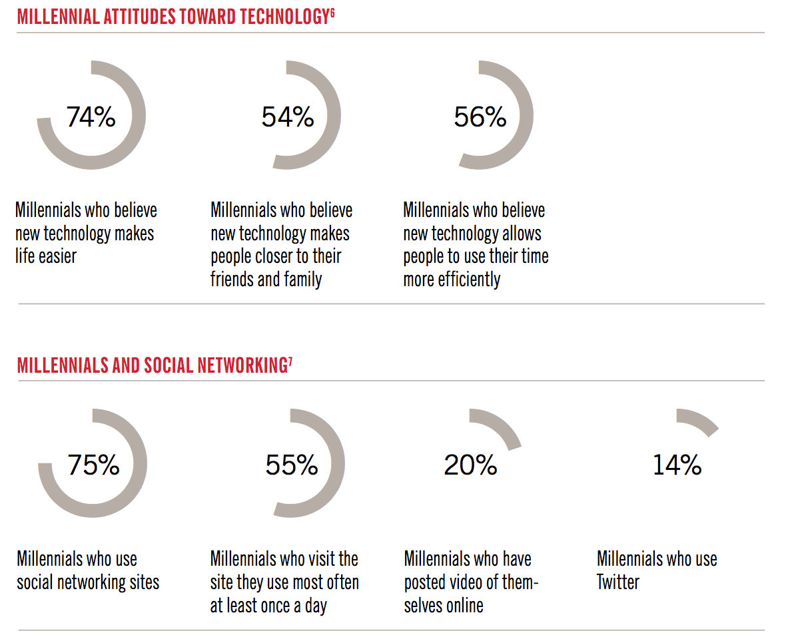
Notes:
Finally, let’s talk about how to reach Millennials.
Embrace technology
Agents that have a strong social media presence, manage a user-friendly website and can offer the market relevant and fresh content that speaks to what we have discussed, have the best chance to impact the purchasing decisions of a Millennial.

Slide 23

Notes:
Be cognizant of the way that you format your content. 6 in 10 access real estate information on a tablet or mobile device.
Unlike the generation of clients before them, Millennials don’t always follow a linear consumer journey. Millennials frequently take a more circuitous path –searching, browsing, seeking reviews and recommendations, all BEFORE ever any meaningful contact with an agent. This is the age of “well I had a friend who” and “well I’ve heard…” or “I know from looking on line…”
59% of millennials in a recent poll regularly write product or service reviews. And almost half of this number or 28% of millennials in this same poll indicated that they rate reviews by others as a “significant factor” in their decision to purchase a product.

Slide 24
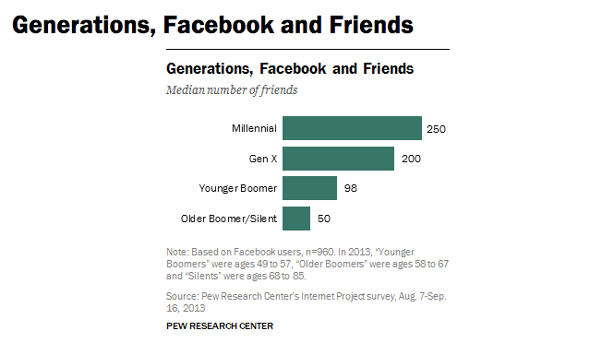
Notes:
This takes word of mouth and it’s importance to a whole other level. If harnessed, this can be an extremely useful tool. Conversly, the other edge of the sword can be a daunting thought as a bad review can go viral.

Slide 25
Notes:
We are just beginning to see the purchaser power of this generation and the impact on the market. This group will challenge, expect more, desire collaboration and redefine our roles more than many of us expect, but understanding the change in the weather will help forge the relationships today that leads to their loyalty throughout their lifetime.

Slide 26
Marketing New Orleans Properties to the Modern Client
David Favret
French Quarter Realty
davidfavret.com

